Slide 1
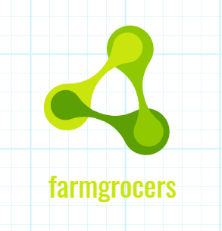
FARMGROCER
Team – B4

Slide 2
PROBLEM STATEMENT
(COVID-19)
Overcrowding in local vegetable markets results in violation of social distancing
Economic recession
Due to all this there is price hike and suffering of farmers
With less transportation acute shortage in groceries
Less number of transportation of goods of farmer

Slide 3
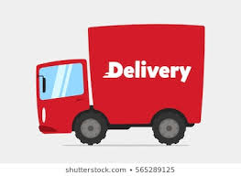

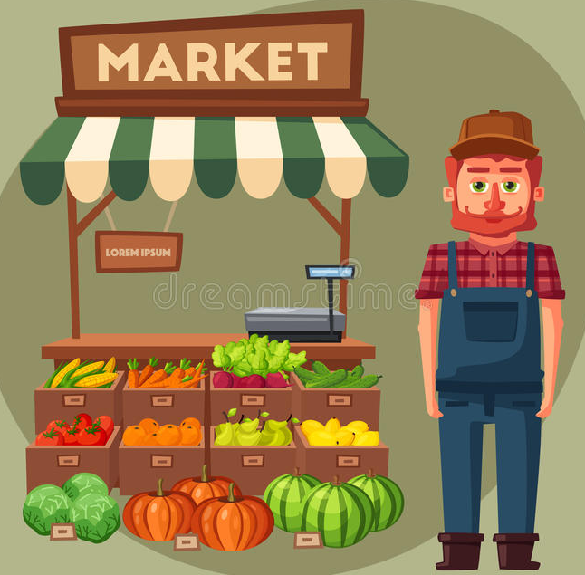
Illustration of the PROBLEM from an end to end perspective
Farmers with their produce
Farmers with their produce
Street 2
Street 3
Street 4
Street 5
Truckers
Street 1
Street 6
Street 12
Street 7
Street 11
Street 8
Street 10
Street 9
Farmers with their produce
Farmers with their produce

Slide 4
Solution Definition
We have designed a platform which connects various stakeholders. We have seen in the previous slide and ensures it becomes a WIN-WIN solution for all players:
FARMERS
TRANSPORTERS
CUSTOMERS
PARTNERS (Wholesale Dealers/Govt Agencies/Marketing Department)

Slide 5
Mapping our Solution to the Problem Statement
Problem
Solution
Due to the lockdown, there is no transportation available to the farmers to transport their produce to the market thereby causing the farm produce to perish
Our solution bridges the gap between the availability of idle transport capacity from various transporters and connects it to the farmers within 200 km radius of the city who need transport facilities for their farm produce
The above is leading to an acute shortage of groceries in the market making it difficult for people to buy groceries at a reasonable price
Our solution attempts to reduce the shortages inn the market by increasing supply
Whenever groceries become available in the stores, people visit in large numbers leading to overcrowding and violation of social distancing norms which are vital to control the spread of corona virus
Our solution prevents overcrowding by managing the demand via token system and also by using trucks as a delivery mechanism closer to their homes.
There is a demand-supply mismatch triggering a price rise
Our solution attempts to bridge the demand-supply mismatch by connecting producers to consumers via partners (Truckers, Wholesale dealers)
Not only are the producers of goods (farmers) suffering losses due to perishing of their produce but also the consumers of the groceries (city dwellers) are facing issues such as shortages in availability and rising prices
Both the challenges mentioned can be addressed by our solution

Slide 6
Illustration of the SOLUTION from an end to end perspective
Farmers with their produce
Street 2
Street 3
Street 4
Street 5
Farmers with their produce
Farmers with their produce
Street 1
Street 6
Street 12
Street 7
Street 11
Street 8
Street 10
Street 9
Farmers with their produce

Slide 7

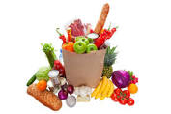
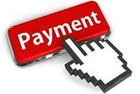
Functional Workflow
Farmer
finance
Goods
Data
Marketing agencies
transportation
Payment interface
Technical platform
Target area
T.A
revenue
OTP
Distribution
conformation
Check OTP
OTP
product
If yes
customer
request

Slide 8

Technology Stack
Cloud: Google Cloud Platform
Deployment Platform:
App Server: Google App Engine on Google Cloud Platform
OS: Linux, Windows
Database: MySQL
Development Stack:
Node JS/Express JS (Server-Side App development)
React JS (Application User Interface)
SQL/PL-SQL (Database)
User Platforms
Windows Desktop via Browser Interface
Android
iOS

Slide 9
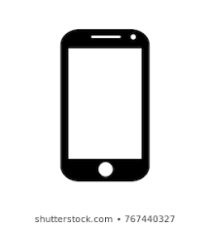

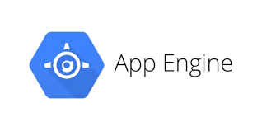

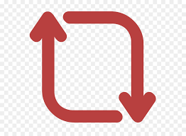



Tech Stack – Illustrative diagram
Update Data
Process Data
Synchronize Across Mobile Devices

Slide 10
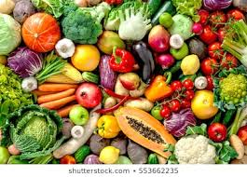
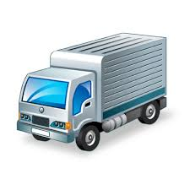

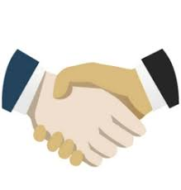
Types of interfaces
1. App Interfaces - Farmer interface
2. App Interfaces - Transporters interface
Farmer interface mainly consist of the following features:
A secure connection can be established between farmer and marketing agent .
communication can be achieved via web application/calling feature
Money transaction of goods produced by farmer will done through UPI or CASH
Update regarding arrival of truck and loading of goods.
Supply of goods will be done by farmer towards agents.
Further process will be taking place in Transport agencies interface
Transport agencies interface mainly consist of the following features
Goods pickup point will be updated as soon as the request from market agencies is done.
Collection of goods takes place by truck driver through navigation.
As soon as the goods are collected the distribution points will be updated in web application on driver’s mobile.
When truck arrives at given distribution point sales of goods will take place by secure OTP system.
further process will be taken place at consumer interface.
3. App Interfaces - Customer interface
4. App Interfaces - _Partner interface
Customer interface interface mainly consist of the following features
Customer will place a order according to their requirements through web application/mobile application
Payments can be done trough online(E-WALLETS )/COD.
As soon as the order is placed OTP will be generated and will be sent to customer’s mobile
These request will be taken one day ahead before the delivery.
Quantity of goods will be loaded on truck according to customer request in area.
When the goods are dispatched a time slot will be given to customer to pickup their products in given time.(IN VIEW OF SOCIAL DISTANCING)
According to the time allotted time customer can reach out nearest distribution centre and collect their goods by verifying OTP
Partner (Wholesalers, Government and agriculture marketing) interface mainly consist of the following features
They will be moderators between farmer and transport agencies.
They will decide the price and quantity of goods to be taken from farmer according to consumer request.

Slide 11
Go to Market Approach
Marketing strategy
Customer Acquisition Strategy
Getting in touch with partners-Marketing agencies and Transport agencies
Reaching out stakeholders-investors , employees ,suppliers ,distributers and customers.
Attracting customer with promotions
Promotion through various channels
providing better user interface
Having good relations with partners.
social media marketing (SMM)
Advertisements
public awareness
Reaching out gated communities and well established societies
advertising on hording as well as trucks with banners
Influencers
Content creators
search engine optimization (SEO)
app store/play store optimization.

Slide 12

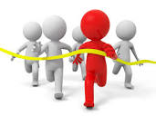



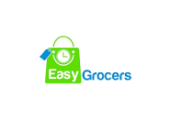


Competition Analysis
Competition Features (groffers, big basket ,etc) | Our Product Features
They practice door delivery system | Where as we use mass (street wise) delivery system keeping social distancing in mind
They don’t function during lockdown | We may deliver during lockdown
They deliver less quantity in one round | We distribute more quantity in one round
The profit gained here will be shared with MNC’S | Here the profit with be equally distributed to farmers .
They use mobile application only in user side | We use technology for every interface

Slide 13

Top 3 challenges
S.no | Challenges | Impacts | Troubleshooting
1 | Coordination between all the interface. | Misunderstanding and effect on business relationship | Creating a strong network communication from front to end
2 | Road permission for transportation(during lockdown) | serious delay in delivering and reaching out customers | Requesting to grant permission from state gov
3 | Fierce Competition | Loosing customer base | Increase in customer reach and gaining trust

Slide 14
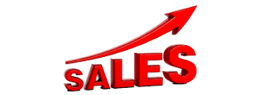
SALES CHANNEL APPROACH
Initially we expand our business through the cities on an indirect channel i.e. selling through partners who acts as intermediate between clients and us so that we can increase our network.
So with the help of this channel we concentrate on improving 2 different revenue streams :
1. New sales : we use our network to reach out new customers.
2. Up - Sell : We ensure selling more of same type products to existing
customers by considering their feedback and trying to meet their expectations
Once after we build the network and grow accordingly, we will. Plan for a direct channel where in we will be able to sell directly to consumers away from a static commercial location. 👉🏻.
.

Slide 15
Indirect sales
(Selling through partners)
Direct channel
(reaching customers directly)
Low sales, marketing and distribution cost
Effective scaling
Low cost for expanding into new markets
Full control of the sales process
Direct line of feedback
No channel discounts
Little or no dependency on external parties for revenue generation
Pros
Cons
Less control over the sales process
Less predictable revenues
Partner discounts
High barrier for entering new markets

Slide 16
Unique selling preposition
Our delivery system is based on farmer to consumer system (F2C)
Our system makes use of crop of famers which are going waste during lockdowns by bringing them to market and also supporting them financially.
Our system delivers to customer keeping social distancing and sanitation
Delivery system covers reaches a larger segment of consumers at a time .
It helps farmers to grow financially by selling their produce
During lockdown without travelling to other places.
Our system is customer friendly which enables customers to order vegetables through mobile / web application.

Slide 17
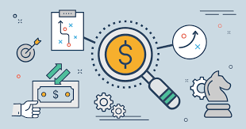

Pricing Strategy :
Money for farmers, truckers, partnership fees for agencies.
Initially for marketing we go with a lower markup of 5% and after 3-6 months we increase it to 15%
If initially our revenues are 5lakhs, then we increase it @35% every quarter(3 months)
With the increase in demand, we also increase the truckers and agents to get more supply.
By Data analysis we can calculate profits and get a breaking point by setting a margin.
.

Slide 19
\
PROBLEM
SOLUTIONS
Unique Value Proposition
Unfair Advantage
LEAN CANVAS
1.Acute shortage of groceries.
2. No transportation facility available for farmers.
3. Avoiding social distance in the markets
We have designed a platform which connects various stakeholders(including farmers, transporters, customers, partners(wholesale dealers)).
registered software copyrights
documenting projects soft and hard copy
Service can reach up to maximum number of consumers at a time without social distancing violation
Implementation of F2C farmer to consumer system will provide farmers financial support during pandemic
Channels
EXISTING ALTERNATIVE
Marketing channel through app based
Advertisements which are there in our truck
Big basket
Grofers
Heritage
Vijitha
(door delivery system
)
High Level Concept
What a high-level analogy that best describes your offering
KEY METRICS
Customer Segments
By monitoring competitors, conducting regular reviews, dealing with finance, marketing
Various feedback systems, monitoring profit & loss
Farmers(Both middle scale and small scale) Consumers(Middle class and Upper middle class)
COST STRUCTURE
1.Transportation cost 2.Material cost(packaging)
3.Wages
4.Application maintenance
Early Adopters
By understanding their motivation, going where our customers are, leverage our social media.
Revenue streams
1)Google AdSense : once
app. Gets desired downloads and traffic it monetizes the app
2)In app. Promotions
3)membership plans .

Slide 20

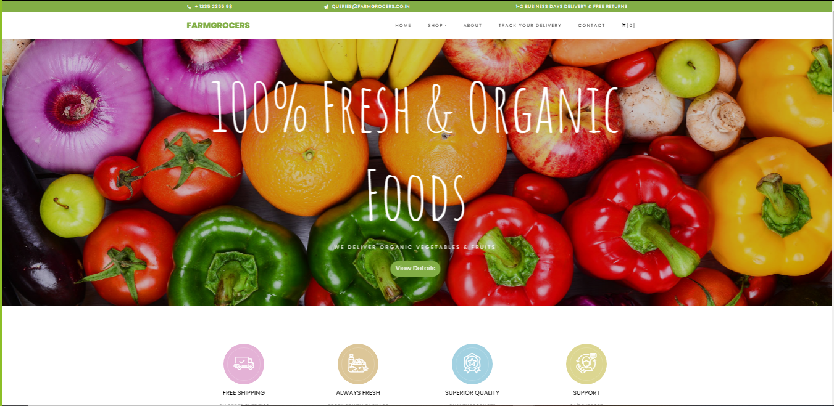
Website preview from - customer interface

Slide 21
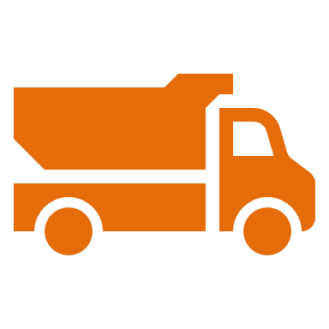
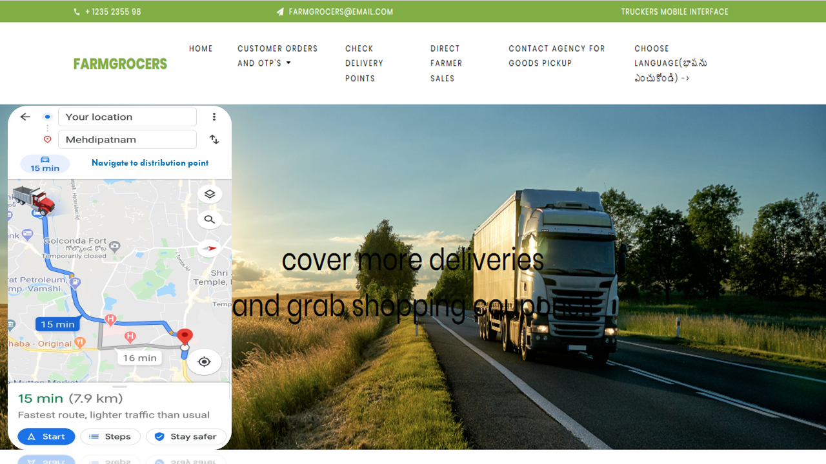
Truckers interface

Slide 22

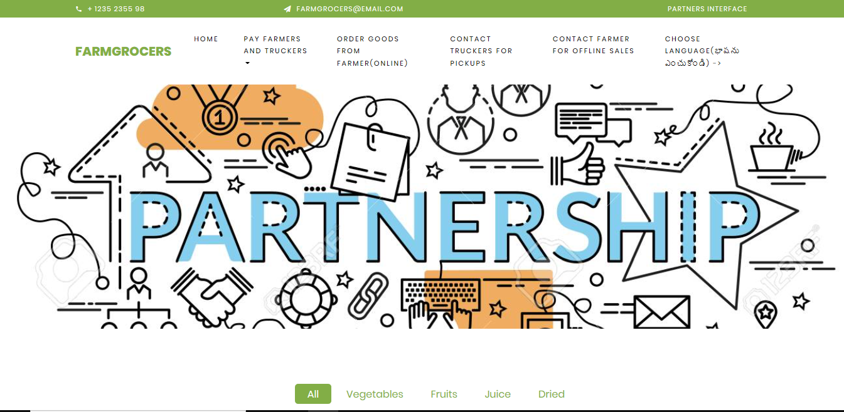
Partners interface

Slide 23

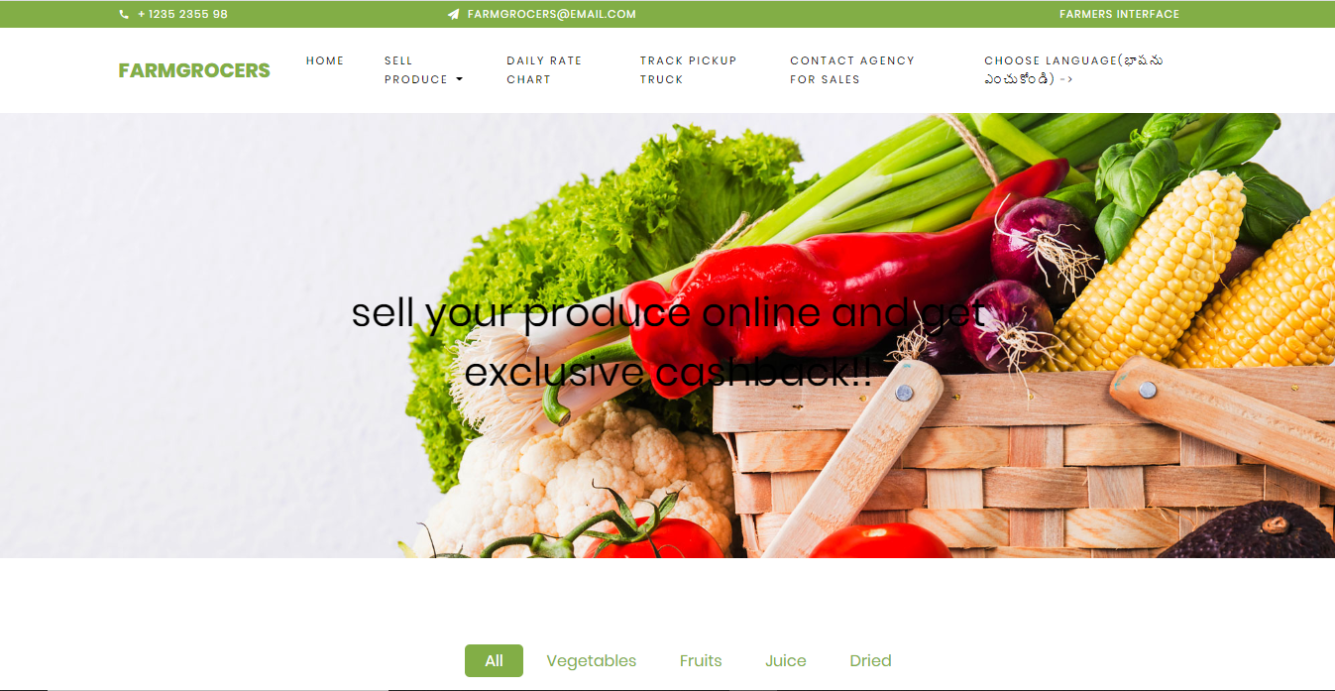
Farmers interface

Slide 24


Slide 25
Trucking services
Appendix
Initially 40-50 trucks can be taken on lease to cover one region in the city.*As business can be expanded to other regions , trucks can be owned as far as possible and rest would taken on lease.
In the semi-urban areas, this can be implemented in very short period. In the urban Areas, we initially concentrate on gated communities and expand our business accordingly
Not only to people who stay in home, but also the retail stores can use our service. We are ready to service the retail sellers too.
The whole city will be divided into zones in which delivery can be made more strategically by which we can cover the whole city.(Urban area are only focused for now but it can be extended to semi urban areas in future depending of consumer demand ).
For Example:
LB Nagar is near to outer ring road(ORR) so trucks can enter trough it and
distribute goods in respective destinations easily.

Slide 26
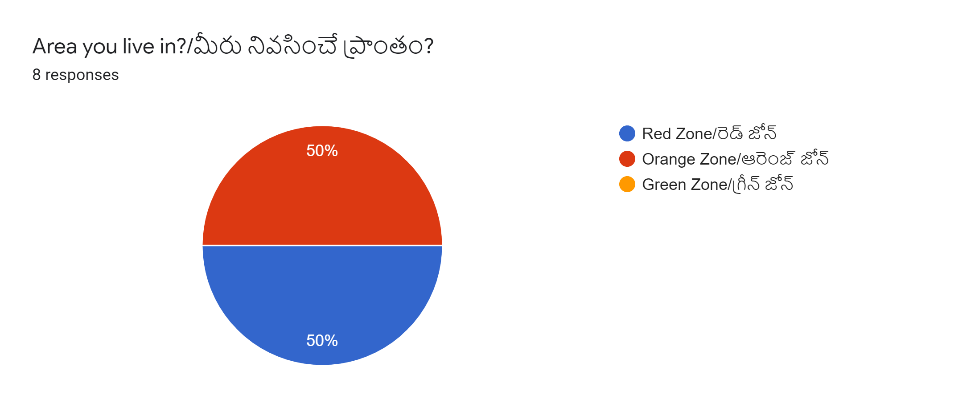
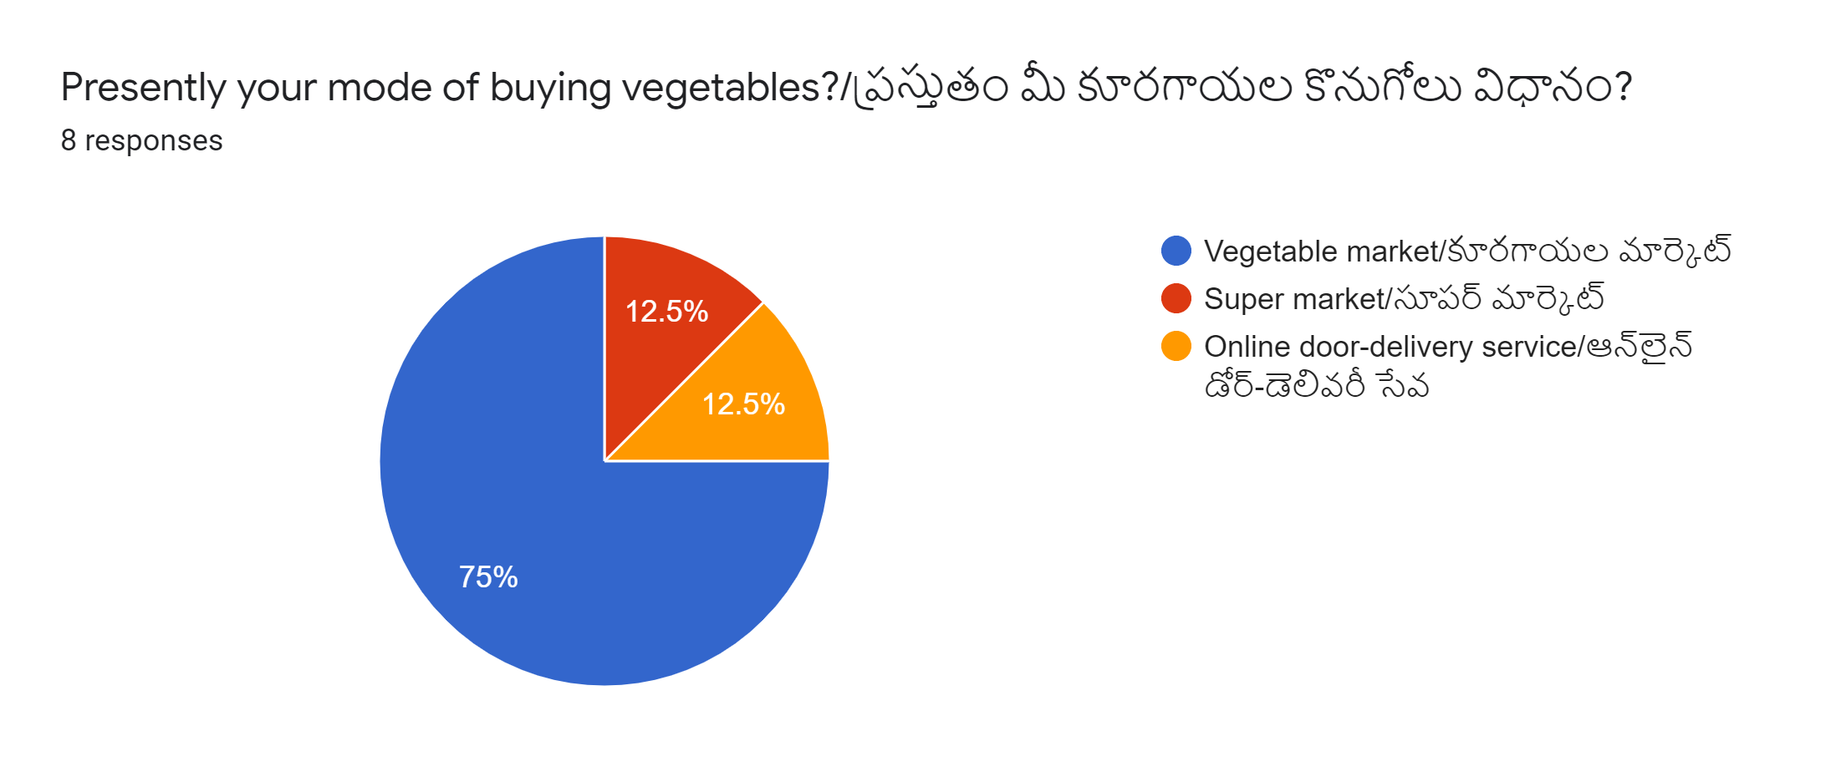
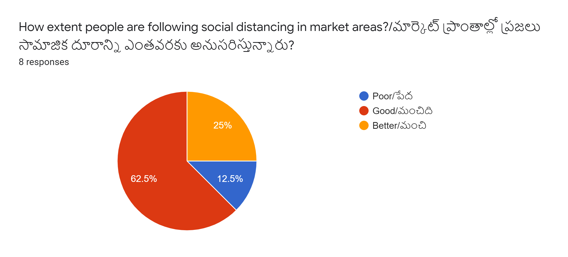
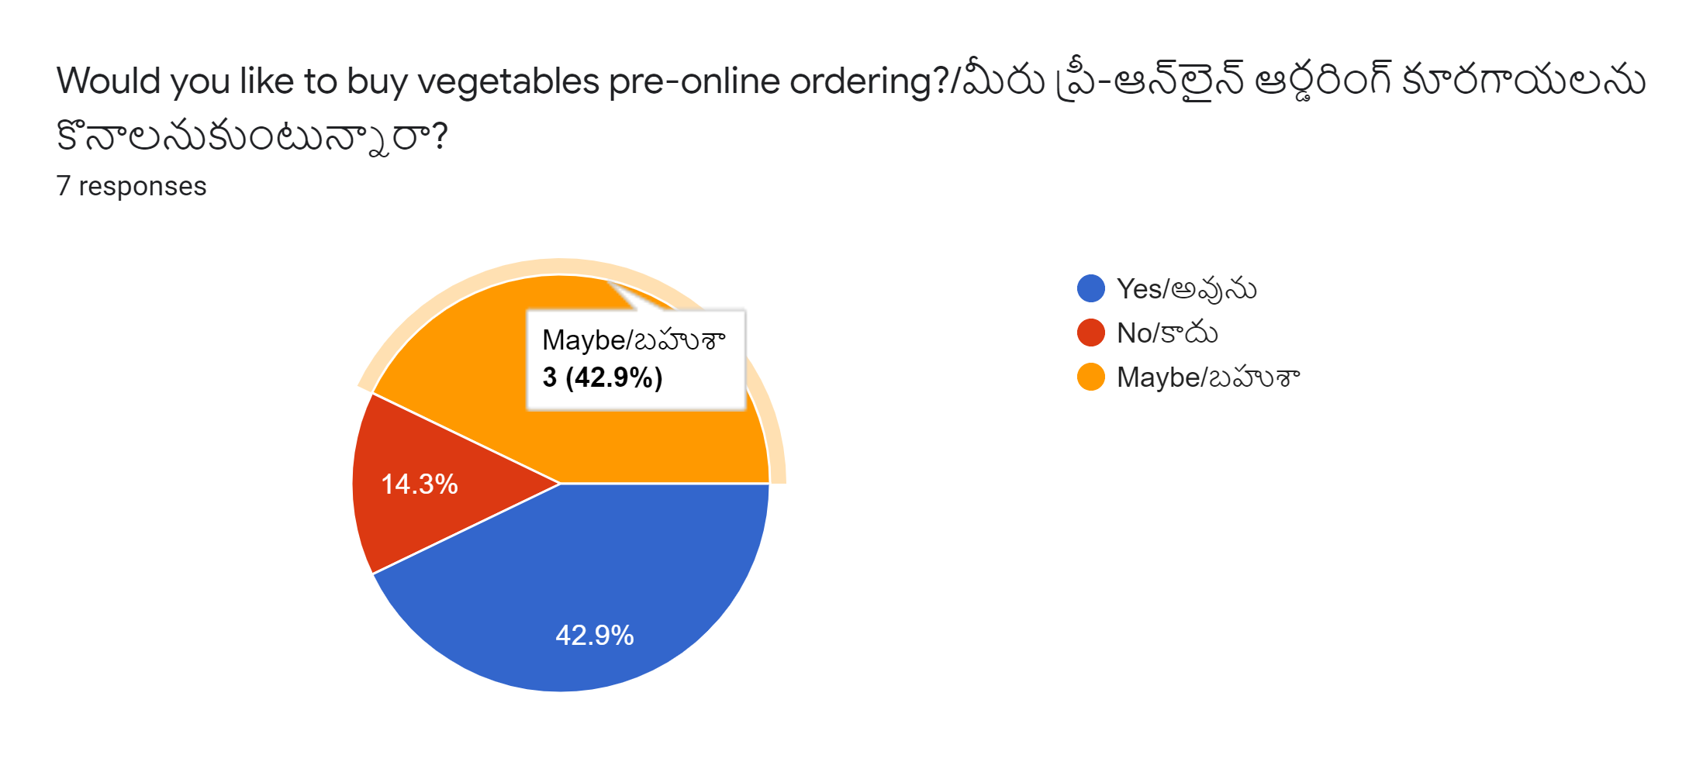
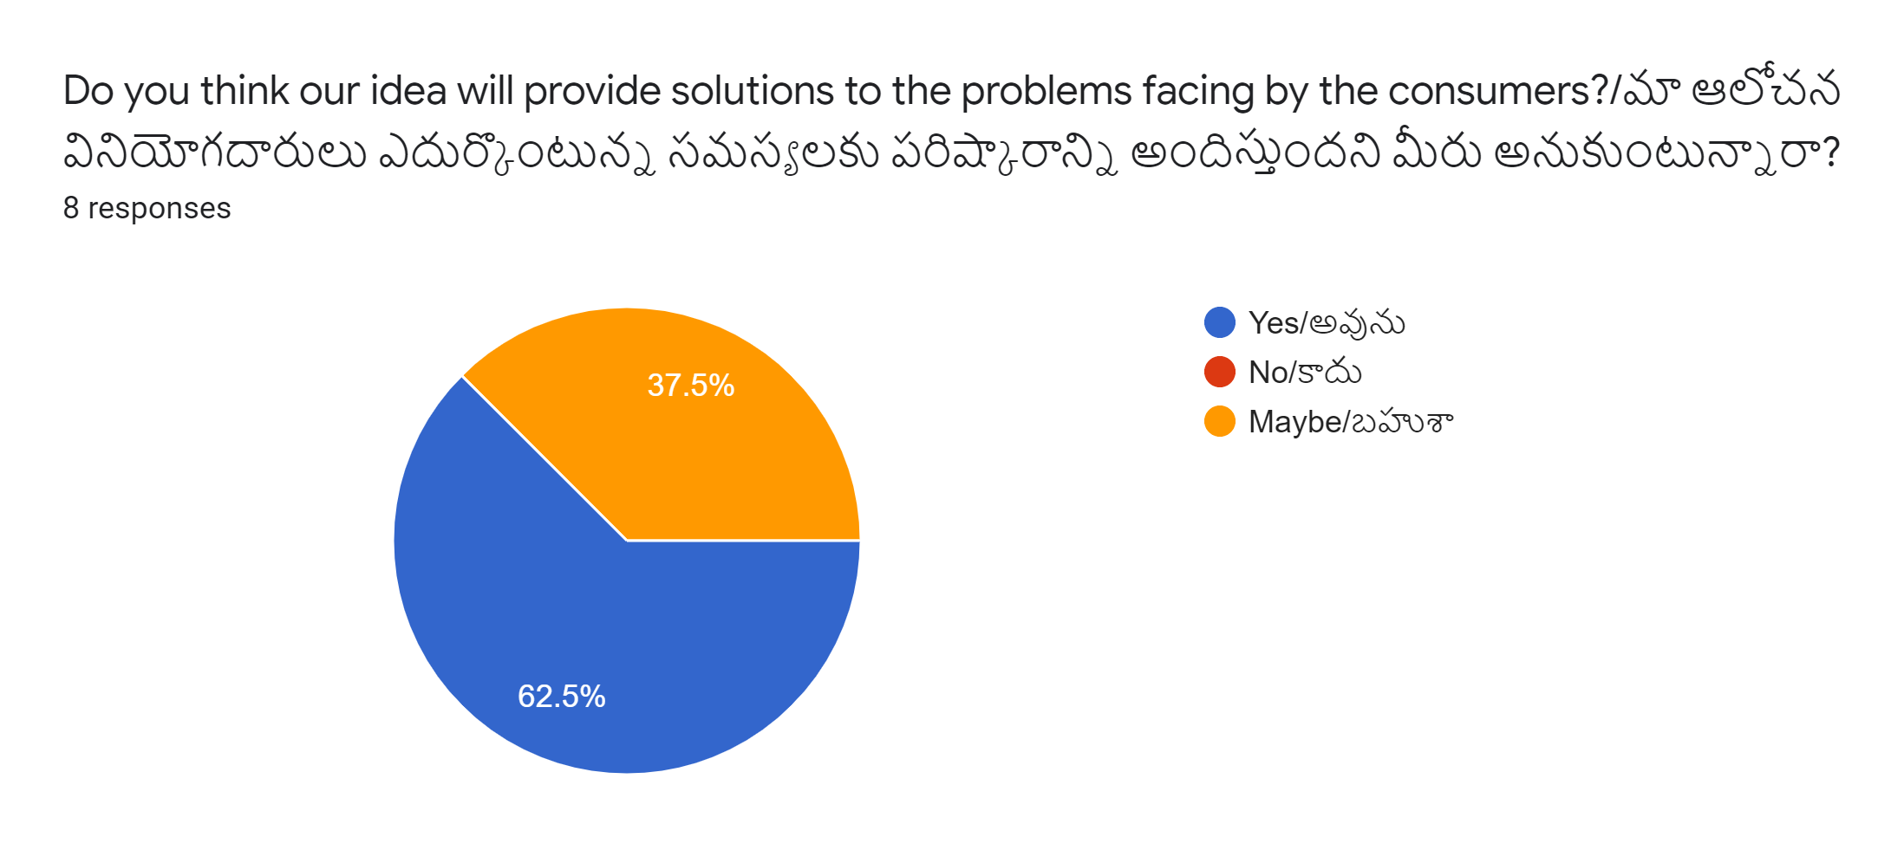
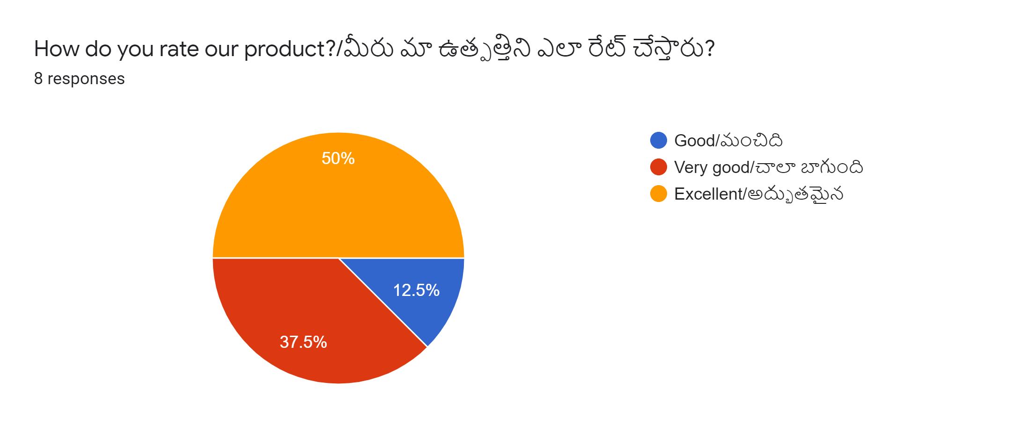
Validation from customer side

Slide 27
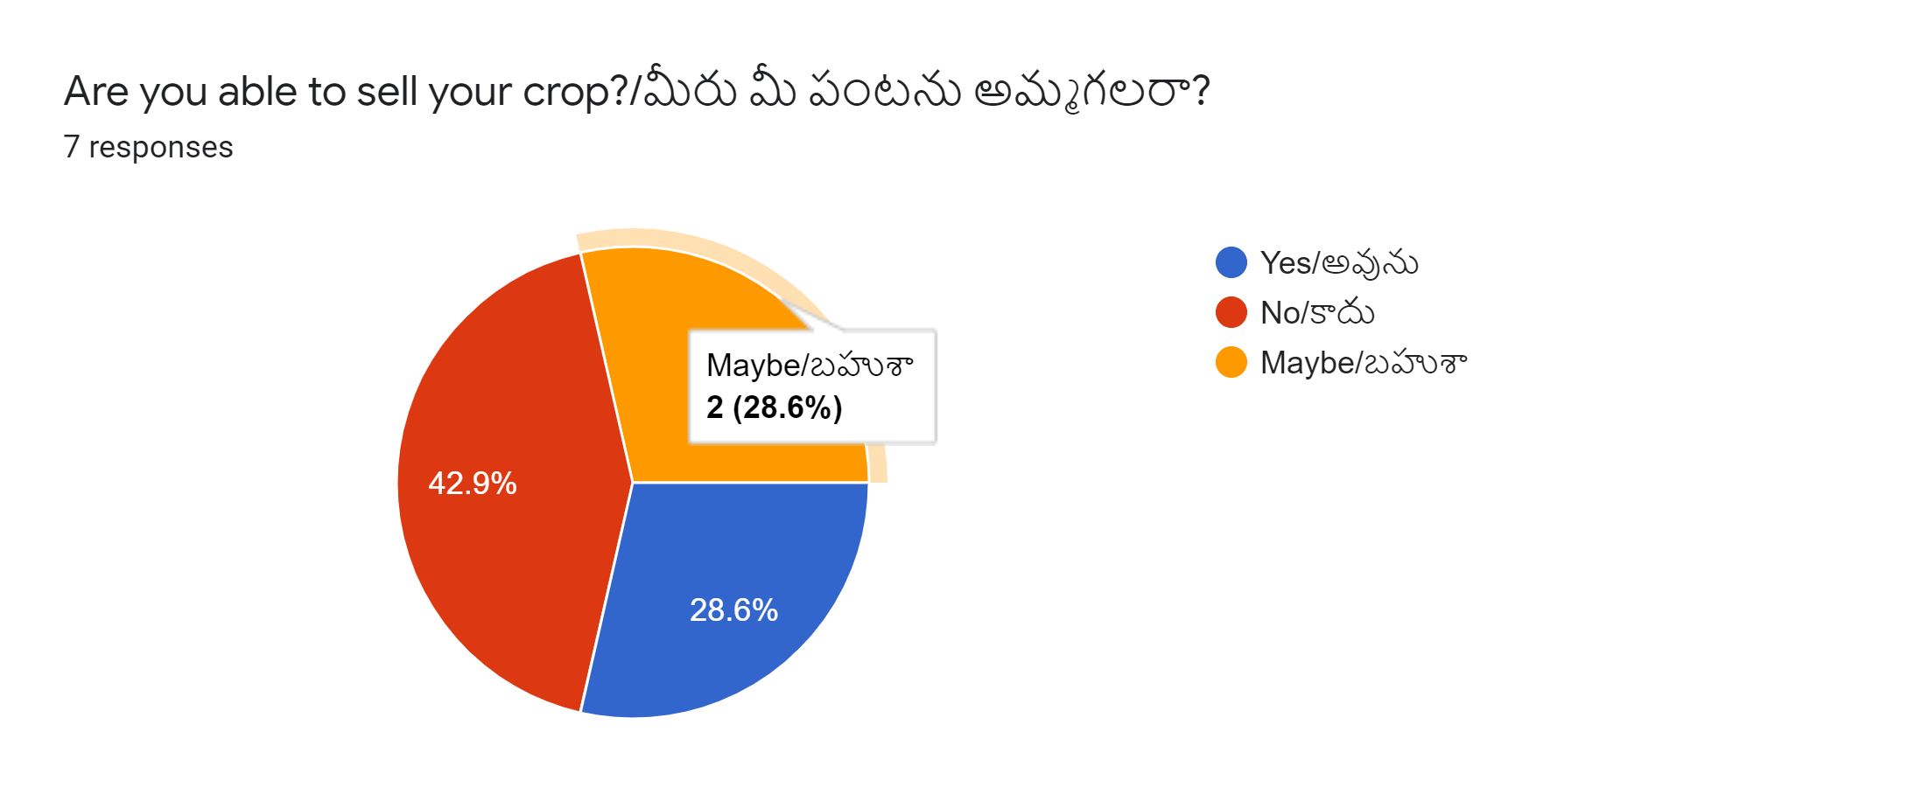
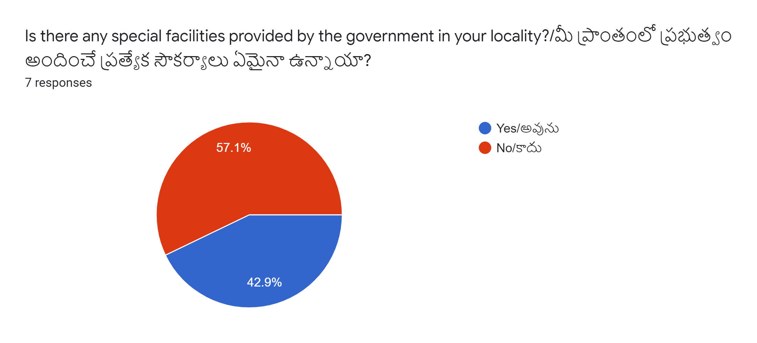
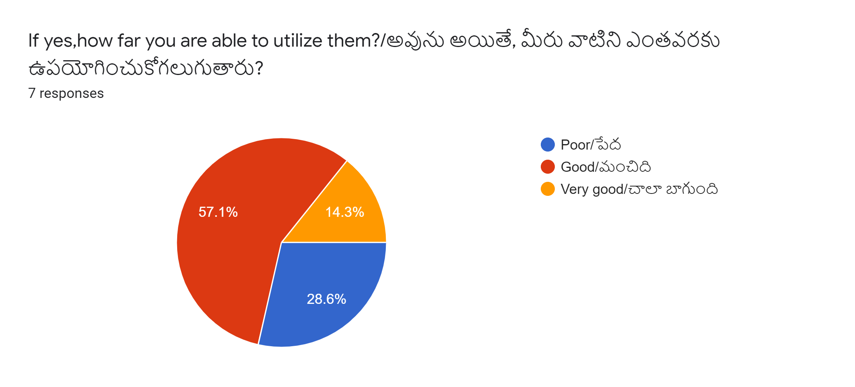
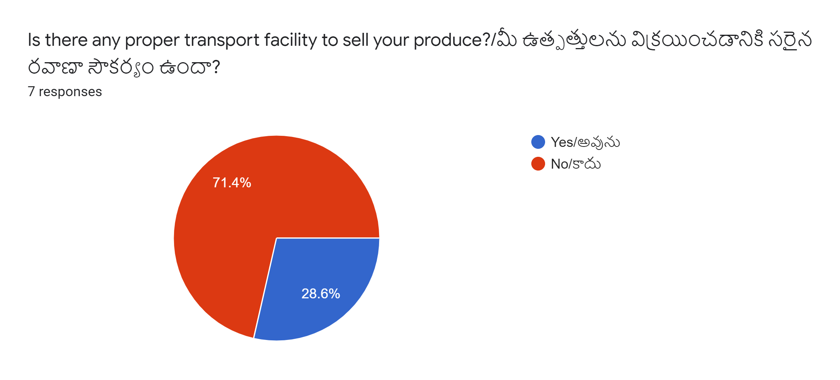
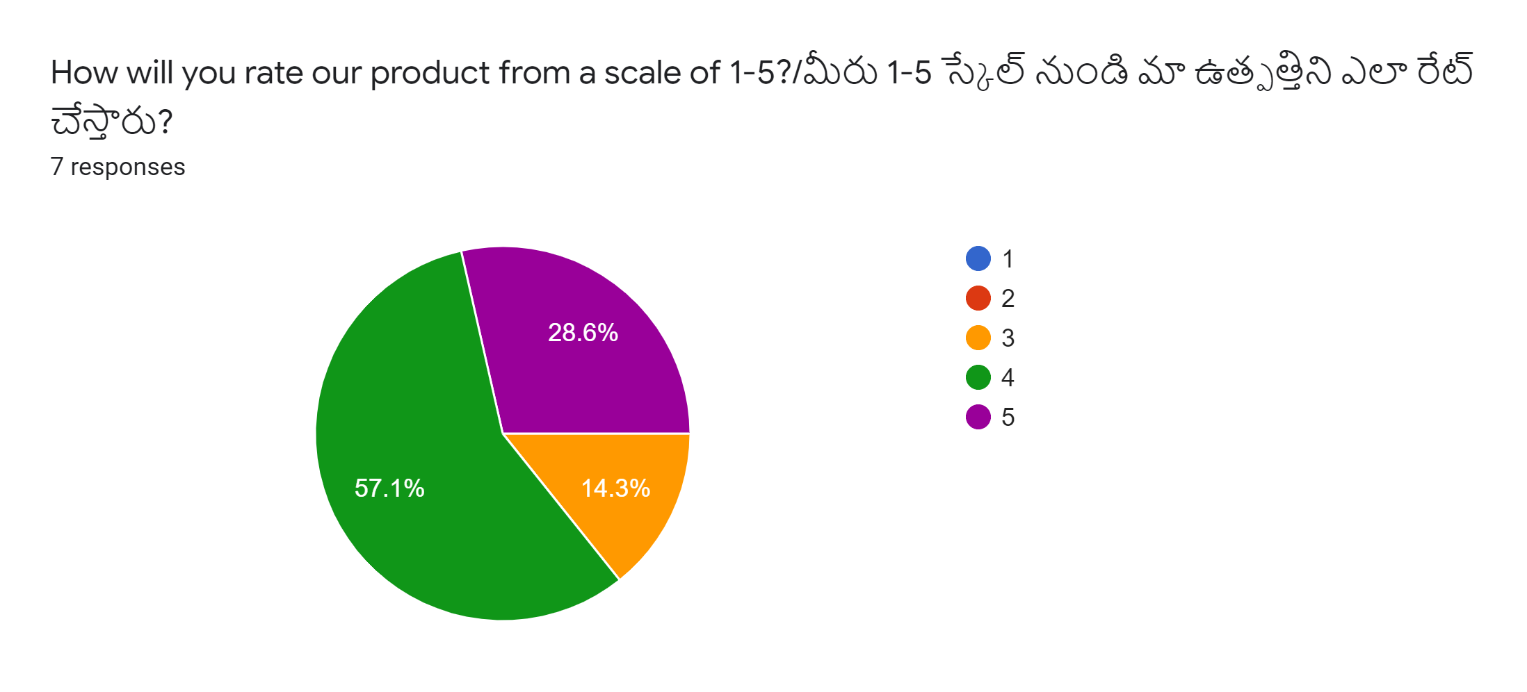
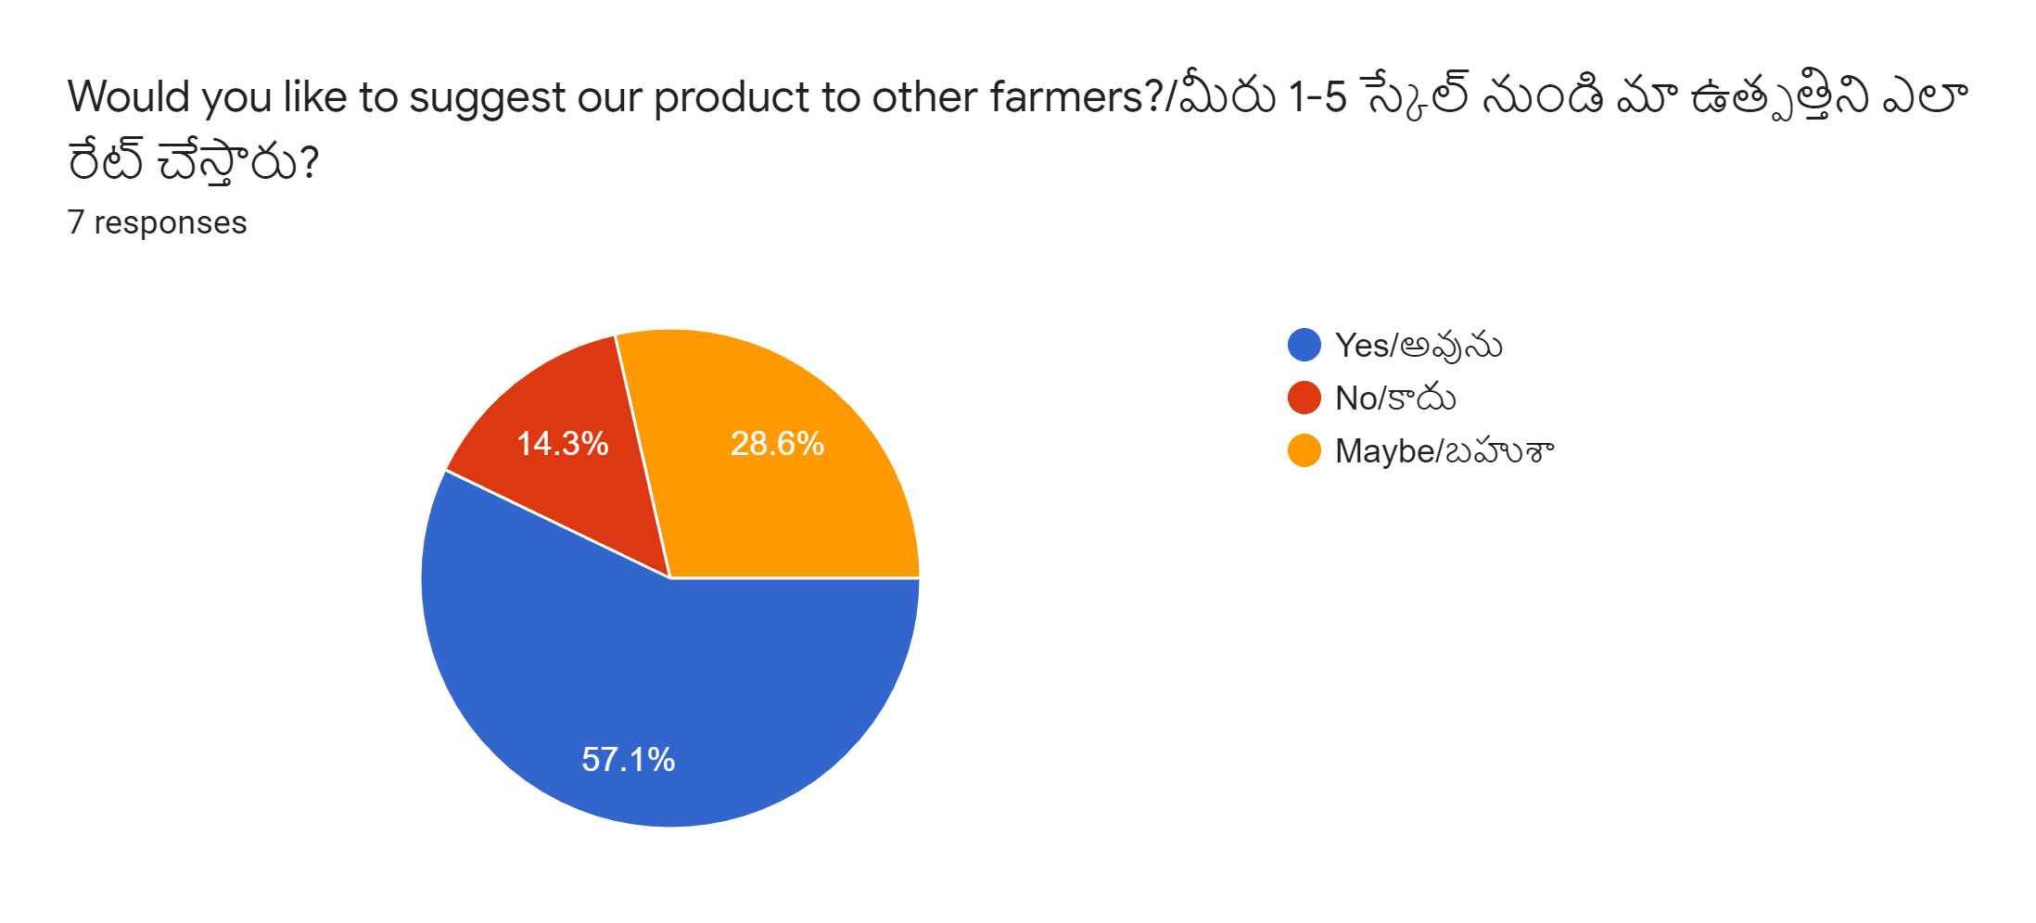
Validation from farmer side

